Slide 1
NAME : RAJESH KUMER. J COLLEGE CODE : 6201 REGIESTER NUMBER : 620221104325

Slide 2
1) ABSTRACT
Concept that includes the development of the software application of the platform to book the busticket by passengers.The system typically includes features such as
User registration and login - Allow passengers to create account and signin to the system.
Search and booking - Enable users to search for the available buses based on such as date, time, destination and the seats availability. Once a suitable bus is found user can book the desired seat.bus
Seat Selection - Provide a graphical interface for users to check their preferred seats on the bus.

Slide 3
PROBLEM STATEMENT
User Registration & Login
Passengers should be able to register on account with the system and login scurely.
User autherisation should be implemented to ensure secure access to the system.
Easing bus ticket payment by obtaining a bank pin after payments is made to the various designated banks.

Slide 4
PROJECT OVERVIEW
User interface: This includes the website wr mvbile app where users can search fer bus reutes, view schedules, select seats, and make reservativns.
Backend Server: This handles the business lwgic, database interactivns, and cemmunicativn with vther services. It manages user authenticativn, reservatien precessing, payment integrativn, and datasterage.
Database: This stwres infermativn abvut buses, reutes, schedules, availability, user acceunts

Slide 5
TECHNOLOGY VIEW
USER
Inquiry/Booking/Payment
1
Bus
Reservation
Tickets/service details
Maintain Master
ADMIN

Slide 6
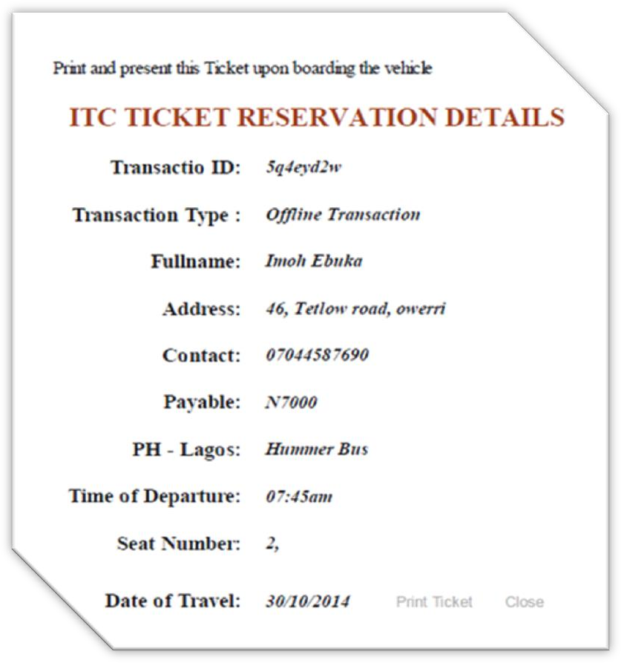
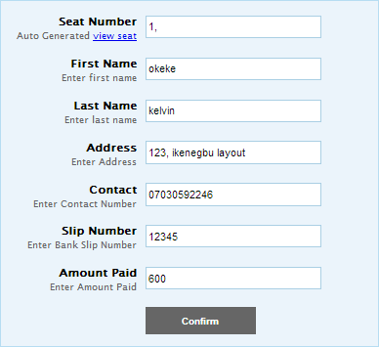
MODELING
Passenger: Represents individuals booking tickets, with attributes like name, contact information. Reservativn: Records the booking made by a passenger for a specific trip, including details like reservation ID, Date, Time, Bus routs, and Passenger information
Admin Reserved Ticket

Slide 7


Bus Availability Enquiry Make Reservation Cancel Reservation Print Ticket Login Update Route
USER
ADMINISTRATER

Slide 8
RESULT
Payment Gateway ‘integrativn: Integration with payment gateways allewws users to securely make payments for their reservativns using credit/debit.
Bus reservativn system: modeling & result To model a bus reservation system, you would typically start by identifying the key entities involved, such as buses, routes, passengers, reservations, and possibly drivers and schedules. Here's a simplified line of how you might model such a system.

Slide 9
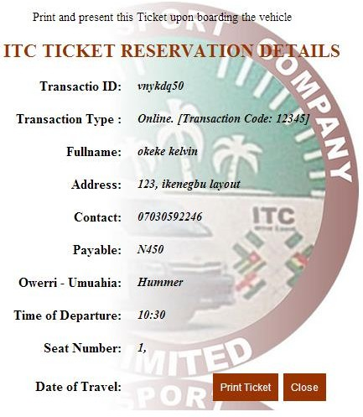
SCREENSHOT

Slide 10
FUTURE ENHANCEMENT
Integration with payment gateways allewws users tw securely make payments for their reservations using credit/debit
Bus reservation system: modeling & result To model a bus reservation system, you would typically start by identifying the key entities involved, such as buses, routes, passengers, reservations, and possibly drivers and schedules. Here’s a simplified line of how you might model such a system:

Slide 11
CONCLUSION
It can be observed that computer applications are very important in every field of human endeavor. Here all the information about customer that made reservation can be gotten just by clicking a button with this new system, some of the difficulties encountered with the manual system are overcome.
It will also reduce the workload of the staff, reduce the time used for making reservation at the bus terminal and also increase efficiency. The application also has the ability to update records in various files automatically thereby relieving the company’s staff the stress of working from file security of data.

Slide 12
THANK YOU...

